Slide 1


H_other_wordcloud_libs.R

Slide 2
Let’s make some pyramids

Slide 3

Steps for a pyramid plot…collapse
Combined/Collapsed
into a 2 document corpus
CorpusA – 1000 Tweets
Clean & Collapse
CorpusB – 1000 Tweets
Clean & Collapse

Slide 4
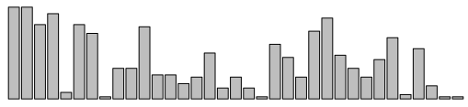
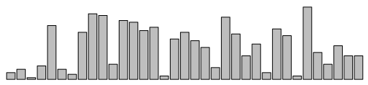
Steps for a pyramid plot…ID common tokens & frequency

Slide 5
Build a “pyramid plot” of frequencies
termA
termB
…
TermN

Slide 6
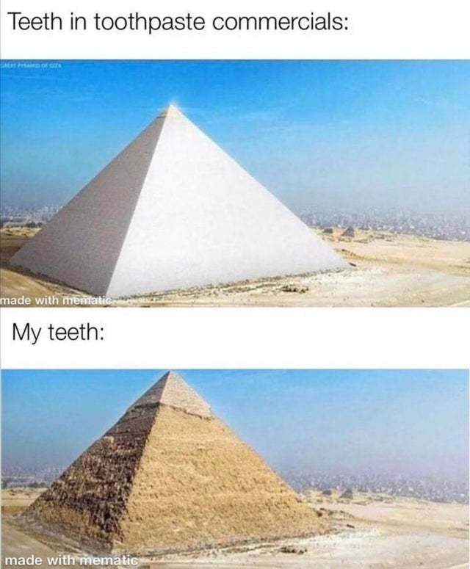
Open ﻿I_Pyramid_plots.R

Slide 7
Open ﻿J_Retailers.R
Not covered due to time. We can revisit later.

Slide 8
A safe/supportive learning environment
We will be using lyrics from popular hip-hop songs late in the lesson. There is a censored version of the data if someone finds it objectionable.

Slide 9
﻿live_K_RapSongs.R
Optional:﻿
live_K_RapSongs_censored.R

